Slide 1
Micro Service Orchistration With Zeebe
Agenda:
General definition of orchestrator
Definition of microservice
Definition of Business workflow’
What is Zeebe
Zeebe Architecture
Features of Zeebe
Choreography problems
How Zeebe solves Choreography problems
Advantages and disadvantages of Zeebe
Sample Zeebe application demonstrations
Oracle Consulting Services, FSGBU

Slide 2
Who is a Music Orchistrator ???
An orchestrator takes a composer's musical sketch and turns it into a score for orchestra, ensemble, or choral group, assigning the instruments and voices according to the composer's intentions
Oracle Consulting Services, FSGBU

Slide 3

What if the Orchestrator miss the instruments coordination???
Music turns into noise !!!
Oracle Consulting Services, FSGBU

Slide 4

Yes an Orchestrator is very essential for melodious ,harmonic music ☺
Oracle Consulting Services, FSGBU

Slide 5
What is a microservice?
Microservices - also known as the microservice architecture - is an architectural style that structures an application as a collection of services that are
Highly maintainable and testable
Loosely coupled
Independently deployable
Owned by a small team
Oracle Consulting Services, FSGBU

Slide 6
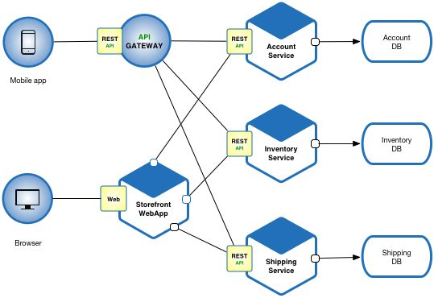
Oracle Consulting Services, FSGBU

Slide 7
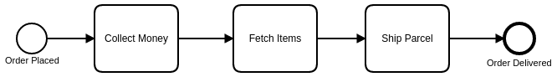
What is a Business workflow?
“A sequence of tasks that allows us to achieve some goal.”
For example, a “customer order” workflow might involve a payments microservice, an inventory microservice, a shipping microservice, and more.
Oracle Consulting Services, FSGBU

Slide 8

A company’s end-to-end workflows almost always span more than one microservice.
These cross-microservice workflows are a company’s core revenue drivers
Oracle Consulting Services, FSGBU

Slide 9

But wait!! Is these revenue generator workflows have not been orchestrated similar to music orchestration?
Oracle Consulting Services, FSGBU

Slide 10
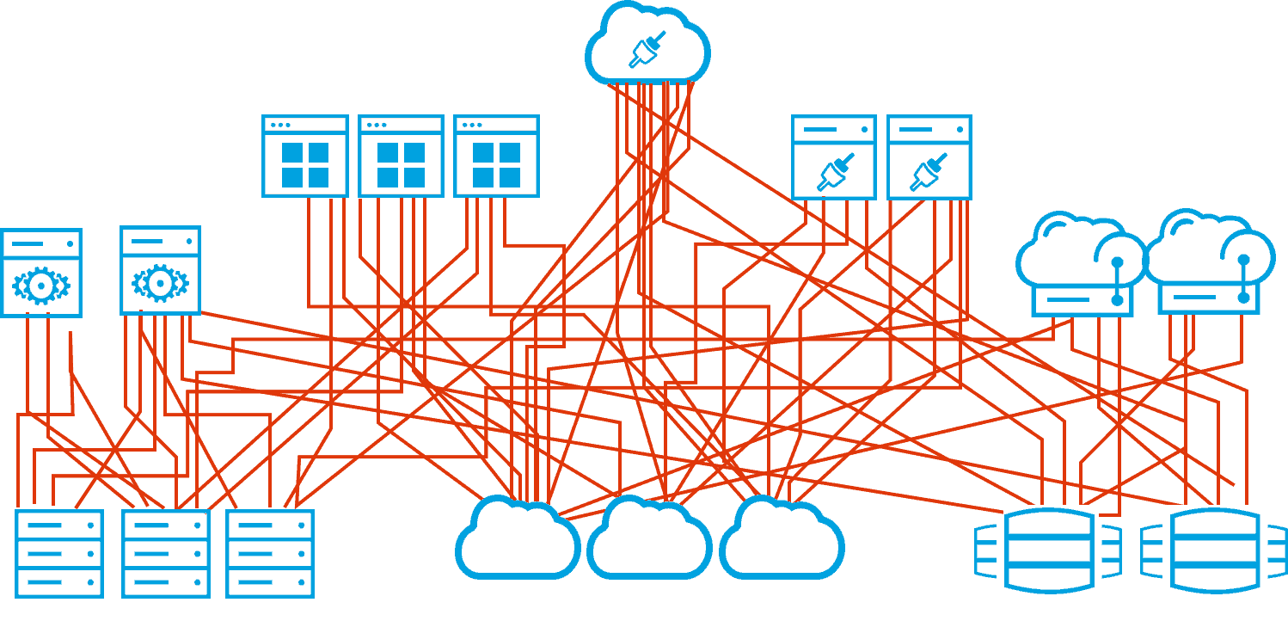
The answer is yes, often, the flow of events through different microservices is expressed only implicitly in code.
Oracle Consulting Services, FSGBU

Slide 11

So here comes couple of questions
How can we ensure visibility of workflows and provide status and error monitoring?
How do we guarantee that overall flows always complete, even if single microservices fail?
How do we at least recognize that a flow is stuck so we can go in and fix it?
Oracle Consulting Services, FSGBU

Slide 12
What is Zeebe?
Zeebe is a workflow engine for microservices orchestration.
In workflows orchestrated by Zeebe, each task is usually carried out by a different microservice.
Zeebe was designed to solve the microservices orchestration problem at very large scale
Oracle Consulting Services, FSGBU

Slide 13
How Zeebe orchestrate the workflow?
Visibility into the state of a company’s end-to-end workflows, including the number of in-flight workflows, average workflow duration, current errors within a workflow, and more.
Workflow orchestration based on the current state of a workflow; Zeebe publishes “commands” as events that can be consumed by one or more microservices, ensuring that workflows progress according to their definition.
Monitoring for timeouts or other process errors plus the ability to configure error-handling paths such as stateful retries or escalation to teams that can resolve an issue manually, ensuring that a workflow is always completed as planned.
Oracle Consulting Services, FSGBU

Slide 14
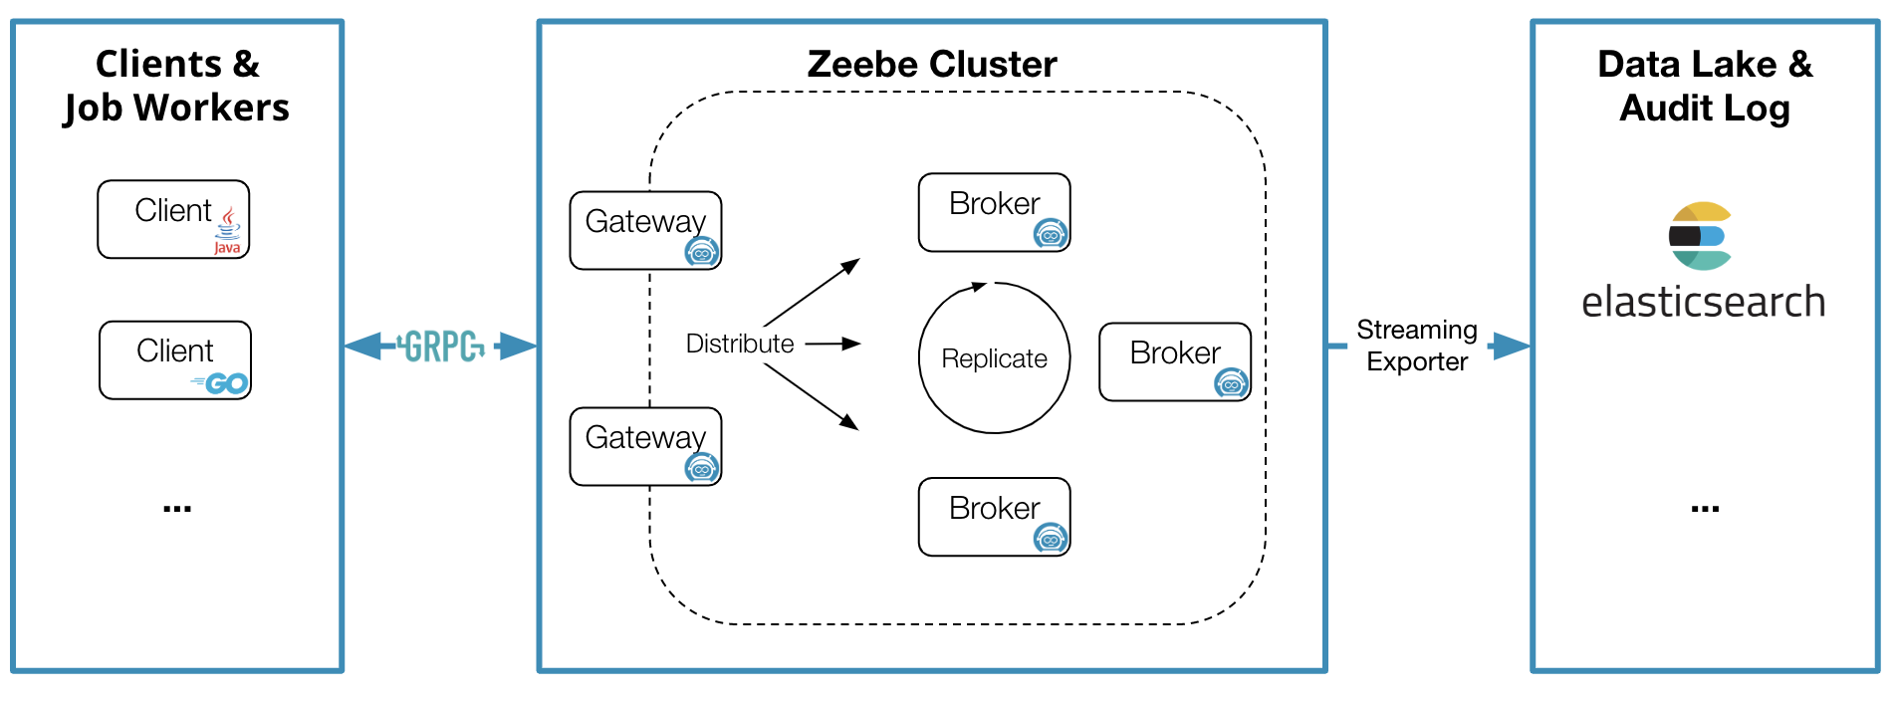
Zeebe architecture
Oracle Consulting Services, FSGBU

Slide 15
Zeebe does not require a central database component and instead leverages event sourcing, meaning that all changes to a workflow’s state are captured as events and stored in an append-only log. In Zeebe, this log is called a “topic”. Topics are written directly to the filesystem on the server where Zeebe is running, and the current state of a workflow can be derived from the events stored in a topic.
Topics can easily be distributed across nodes in a cluster (partitioning) for scalability, and partitions will typically be stored on more than one node (replication) for fault tolerance.
Zeebe uses a client / server model. The server (broker) is a remote engine that runs as its own program on a Java Virtual Machine. The broker is responsible for storing topics related to workflows, distributing work items to clients when appropriate, and exposing a workflow event stream to Zeebe clients via pub-sub. Zeebe clients can be embedded in an application in order to connect to the broker.
Oracle Consulting Services, FSGBU

Slide 16
What features does Zeebe provides to solve orchestration?
Horizontal scalability
Fault tolerance
A message-driven architecture
A publish-subscribe interaction model
Visual workflows modeled in ISO-standard BPMN 2.0
A language-agnostic client model
Oracle Consulting Services, FSGBU

Slide 17
Time to redefine Zeebe ☺
A workflow engine is a system that manages business processes. It monitors the state of activities in a workflow and determines which new activity to transition to according to defined processes.
Oracle Consulting Services, FSGBU

Slide 18
choreography pattern for communication?
Microservices collaborate by publishing events to and consuming events from a messaging platform without a central controller (a model also known as publish-subscribe, or pub-sub).
choreography does not provide:
Visibility
Failures handling
Oracle Consulting Services, FSGBU

Slide 19
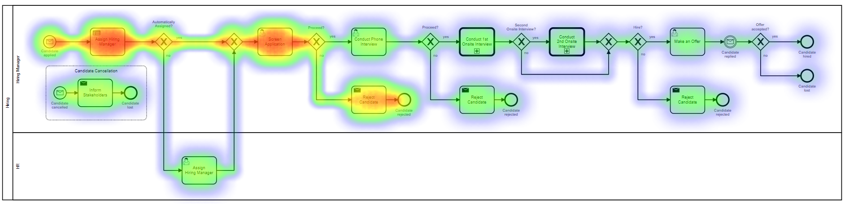
How Zeebe solves choreography visibility problem?
Workflow-Aware Event Monitoring(Heat Maps)
Oracle Consulting Services, FSGBU

Slide 20
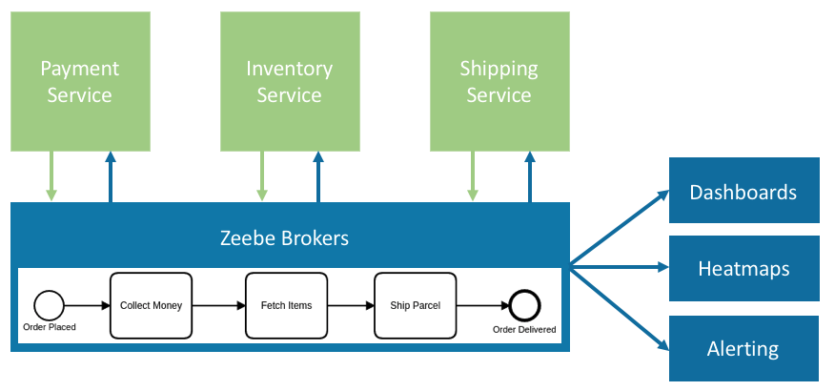
How Zeebe solves choreography Failures handling?
Oracle Consulting Services, FSGBU

Slide 21
You can think of Zeebe’s approach to workflow orchestration as a state machine. When a workflow instance progresses to a certain task, Zeebe sends a message to notify the responsible worker service then waits for the worker to complete the task.
Once a task is completed, the worker service notifies Zeebe, and the flow continues with the next step. If the worker fails to complete the task, the workflow remains at the current step, potentially retrying the task until it eventually succeeds or escalating to a different team if human intervention is required.
Zeebe decouples the creation of task notification messages from the actual performing of the work, meaning that Zeebe can send task notification messages at the maximum possible rate regardless of whether there is a worker service available to take on the work.
Zeebe queues task notifications until it can push them out to workers. If no worker service is currently available, work messages remain queued.
Oracle Consulting Services, FSGBU

Slide 22
Advantages of Zeebe
Zeebe was designed with large-scale workflows in mind (up to tens of thousands of new workflow instances started per second and beyond). Zeebe does not rely on an external database and instead stores data in the form of an immutable log directly on the servers where Zeebe is deployed; this architecture is key to Zeebe’s ability to handle high throughput and to scale horizontally.
Currently, all communication between Zeebe brokers and external services is handled by Zeebe’s clients. Zeebe’s client protocol is programming language-agnostic, meaning that clients can be generated easily in many common programming language.
Zeebe currently covers fewer BPMN symbols than a more mature workflow engine such as Camunda BPM. However, Zeebe adds support for new symbols on a regular basis, and eventually, Zeebe will offer complete coverage of BPMN symbols that make sense for workflow automation.
Oracle Consulting Services, FSGBU

Slide 23
Disadvantage of Zeebe
Zeebe is currently in "developer preview", meaning that it's not yet ready for production and is under heavy development. See the roadmap for more details.
Your applications might not need the scalability and performance features provided by Zeebe. Or, you might a mature set of features around BPM (Business Process Management), which Zeebe does not yet offer. In such scenarios, a workflow automation platform such as Camunda BPM could be a better fit.
Oracle Consulting Services, FSGBU

Slide 24
Time to see some real flow execution with Zeebe
Sample order processing workflow with Zeebe and rest and plain Zeebe
Sample order processing workflow with Zeebe and kafka
Oracle Consulting Services, FSGBU

